Slide 1



SubsTracker
Presented by :
Hassan Al Hussaini
Mshari alshamri
Mohammed alherz
Smart Subscription Management PlatForm

Slide 2
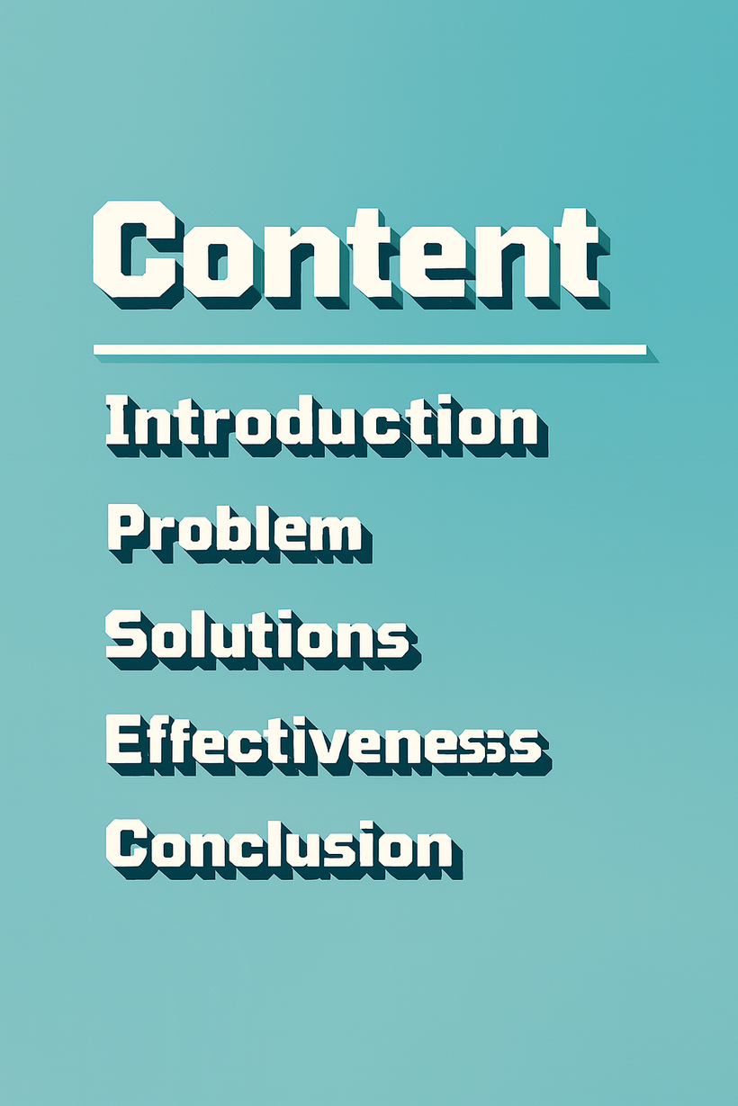

Smart Subscription Management Web

Slide 3
Introduction
Smart Subscription Management Web

Slide 4

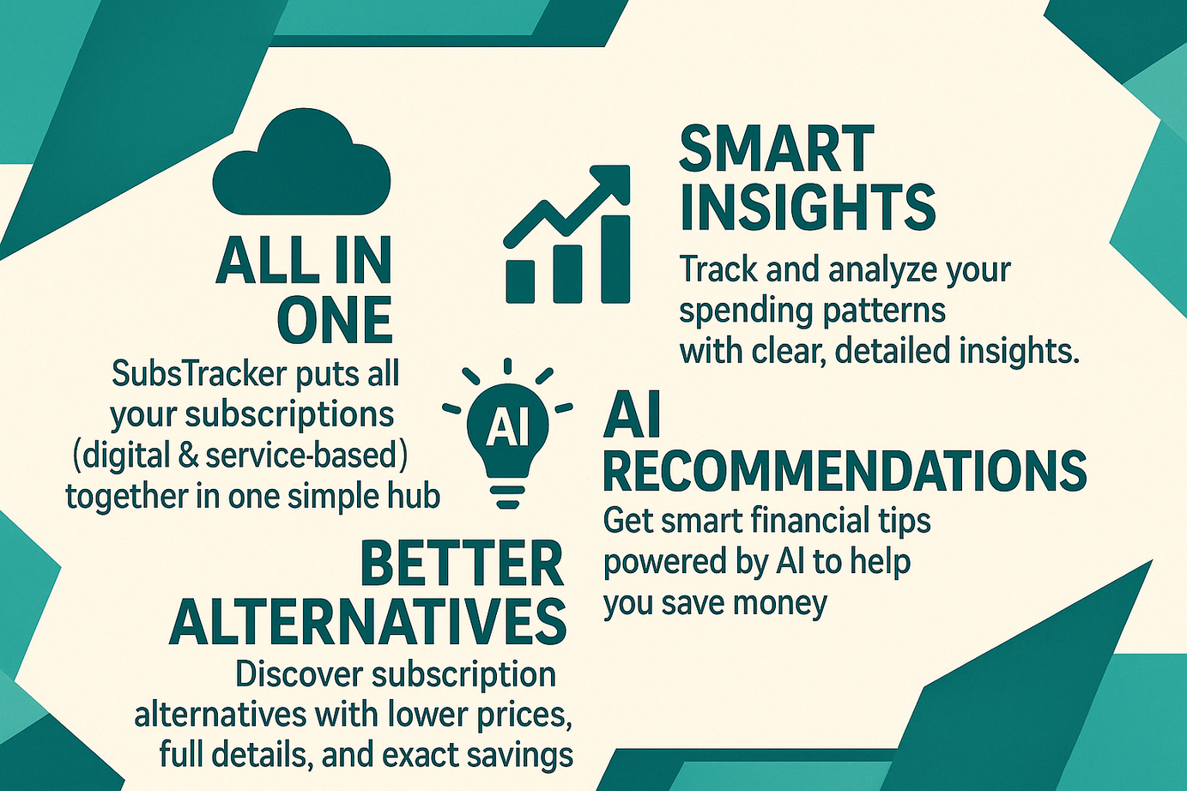
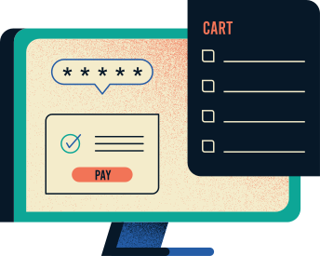
Introduction & Features

Slide 5

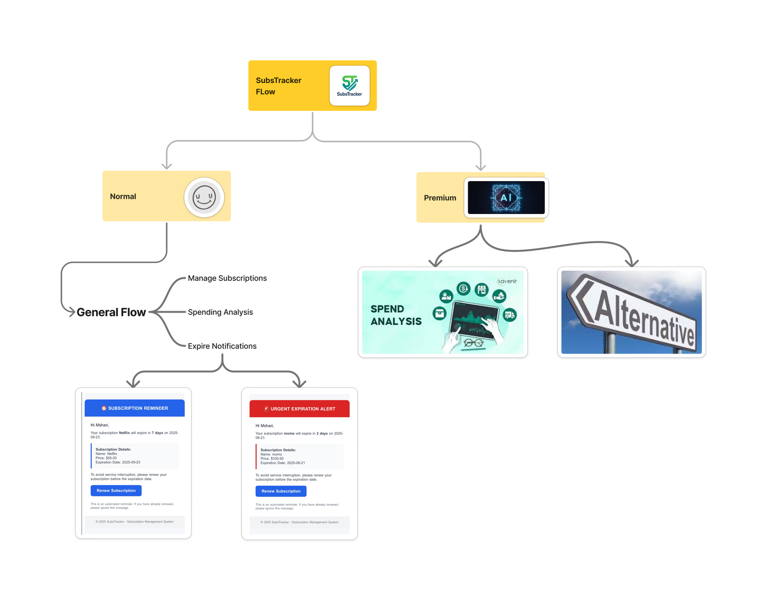
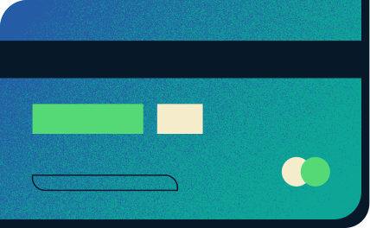
Flow Of the System

Slide 6
Problem
Smart Subscription Management Web

Slide 7

Problem
Users subscribe to many services
Forget renewal dates → sudden service interruption.
Keep paying for unused subscriptions.
No clear overview of monthly spending.
Hard to compare alternatives and choose cheaper options.

Slide 8
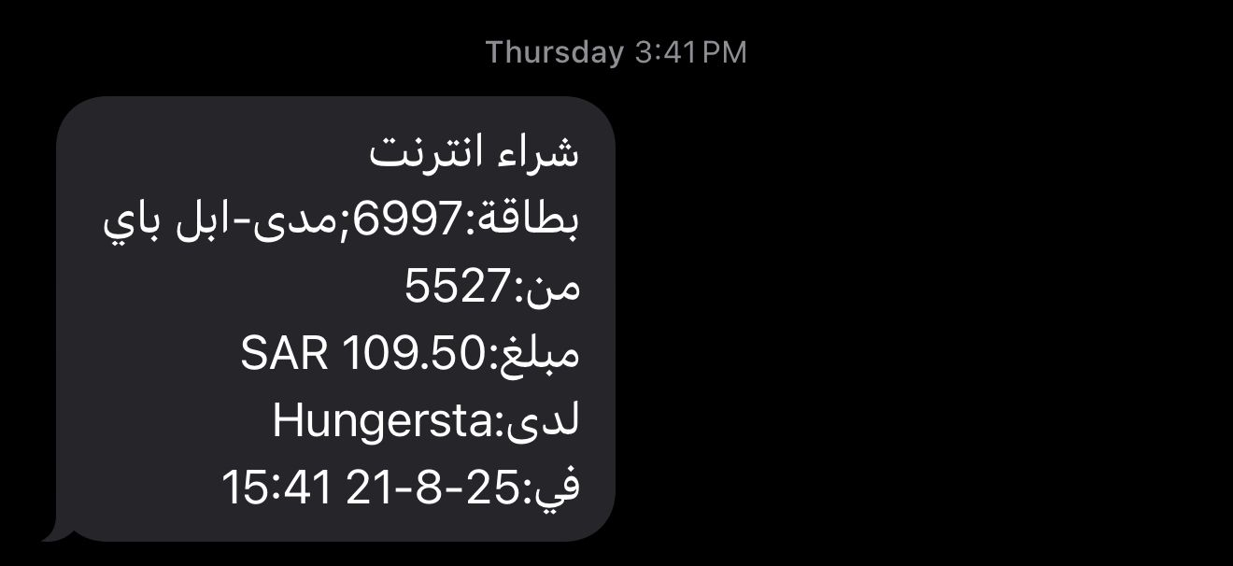

Problem
Real-life example

Slide 9
Solutions
Smart Subscription Management Web

Slide 10


Solution
Centralized dashboard for all subscriptions.
Email alerts before renewal (7 days / 2 days).
Automatic spending analysis (total, average, ratio to salary).
AI-based recommendations to reduce expenses.
AI suggestions for cheaper alternatives.
Professional PDF invoices sent to users.

Slide 11
Effectiveness
Smart Subscription Management Web

Slide 12

Effectiveness & Impact
Core Benefits:
Financial Control: Prevent subscription waste and optimize spending patterns
Smart Notifications: Never miss renewal dates with 7-day and 2-day alerts
Deep Analytics: Category-based insights and personalized recommendations

Slide 13
Effectiveness & Impact
AI-Powered Premium Features:
AI Analysis Subscription: Advanced machine learning insights for power users
Intelligent Alternative Recommendations: AI suggests cheaper alternatives to current subscriptions
Predictive Spending Patterns: AI forecasts future subscription trends and usage

Slide 14
Conclusion
Smart Subscription Management Web

Slide 15

Conclusion
Take Control: Never lose track of subscriptions or face surprise charges again
Save Money: Identify unused services and find cheaper alternatives
Stay Informed: Get timely alerts before renewals and payments
SubsTracker transforms subscription management from chaotic to controlled, helping users optimize their digital spending and achieve better financial wellness.

Slide 16
Testing...
Smart Subscription Management Web

